Slide 1

CITY BANK LENDING ACTIVITIES & PERFORMANCE

Slide 2
Agenda
Project recap
Problem
Process
Insights
Summary

Slide 3

Project Recap
An analysis of City Bank customer’s dataset in different locations in the U.S., to monitor and assess the bank's lending activities and performance towards creating a comprehensive Bank Loan Report.
This report aims to provide insights into key loan-related metrics and their changes over time.

Slide 4

Problem Statement
To create comprehensive Bank Loan Report dashboards that will provide insights into key loan-related metrics and their changes over time. The report will help City Bank make data-driven decisions, track its loan portfolio's health, and identify trends that can inform its lending strategies.

Slide 5
DASHBOARD 1
DASHBOARD 1 -
To calculate Key Performance Indicators (KPIs) which are
Total Loan Applications
Total funded amount: Total Amount of fund disbursed as loans
Total Amount Received – Total repayment by borrowers
Average Interest rate
Average Debt to Income Ratio (DTI)
Good Loan Vs Bad Loan KPI
Good and Bad Loans Application Percentage
Good and Bad Loans Application – To know the total amount of loan falling under each category of good or bad loan.
Good and Bad Loan funded - to determine the total amount of money disbursed as “Good” or “Bad” loan.
Good or Bad Loan total received Amount
Loan Grid Status view

Slide 6

DASHBOARD 2
For Loan Metrics and Trends, we need the following in the dashboard.
Monthly Trends by Issue Date
Regional Analysis by State
Loan Term Analysis
Employee Length Analysis
Loan Purpose breakdown
Home ownership Analysis

Slide 7
PROCESS
Identifying the necessary dataset for the project
Cleaning the data to ensure it’s good for the next stage.
Calculating some measures using the IF function and NUMBER AND DATE formatting prepare the dataset for analysis
Creating the different PIVOT TABLES needed to create the required dashboards for the analysis.

Slide 8
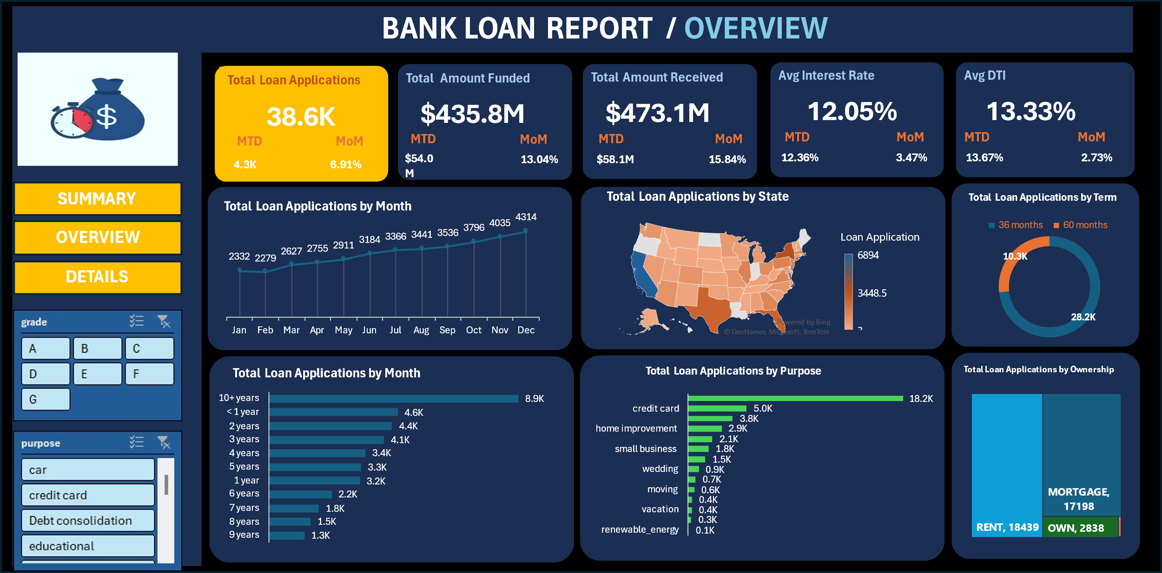

Slide 9
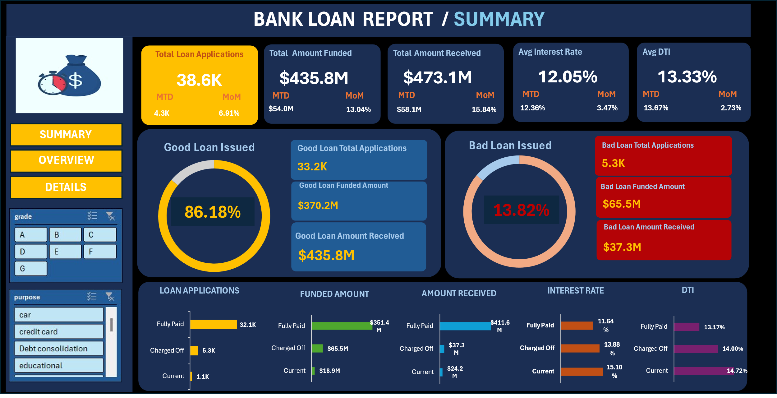

Slide 10

Result and Findings
A total of 38.6k loan applications were received by City Bank.
The bank disbursed a sum of $435.8M as loans and received a total sum of $473.1M as loan repayment.
The average interest rate over the period in question is 12.05% with the Debt -To- Income ratio being 13.33%
33.2k loan applicants which is 86.18% of the borrowers, got a total loan of $370.2M. They have either paid back their loans or are currently servicing them. A total sum of $435.8M has been paid back and written as "Good Loans"
While 5.3k applicants which is 13.82% of borrowers who got a total loan sum of $65.5M have been charged off and written as "Bad Loans"
The borrowing trend increased from January, peaking in December with 4314 applicants. January has the least month per applicant with a total of 2332 applications.
To seek a loan, Debt consolidation has the highest number of applications with 18.2k applications, while renewable energy has the least with 0.1k applications.

Slide 11

Recommendations
Based on the analysis done, I will recommend the following actions
The bank can work in conjunction with renewable energy companies and create "special interest" products around January to entice borrowers to take loans for the products.
The Bank can incentivize timely loan payments to encourage more defaulters to service their loans as, and when due.
A very small percentage took loans for vacation purposes. The bank can create a marketing campaign about work-life balance and offer a special vacation package to attract families to go on vacations.
Implement a customer segmentation strategy to target different categories of customers with loan packages that will be beneficial to them.

